Slide 1
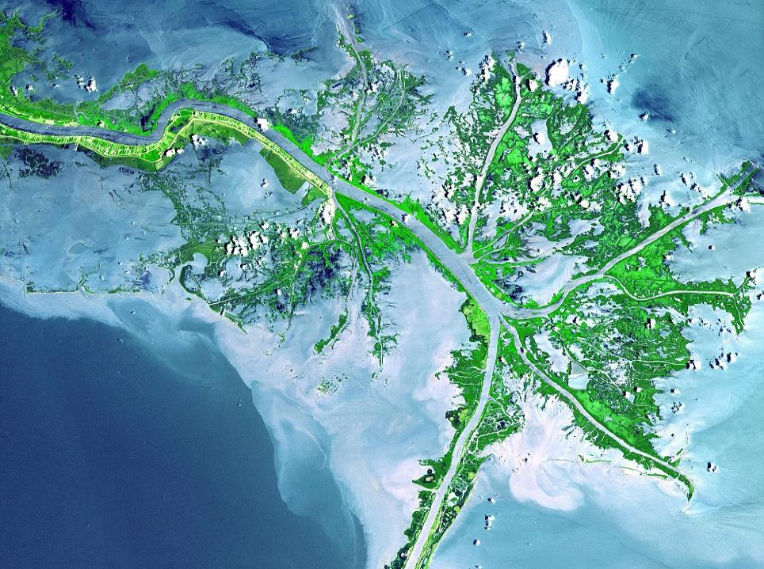
EART11100: Understanding the Earth
A dynamic Planet
Sedimentary (or “depositional”) environments
The Mississippi Delta, USA, is where sediment eroded from the Rocky Mountains by the river is deposited.

Slide 2
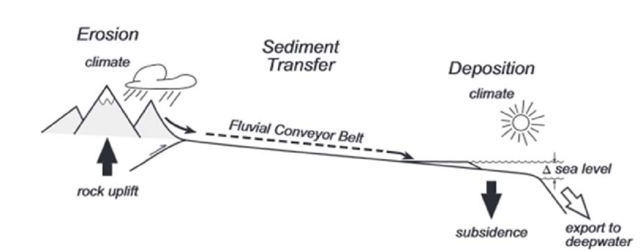
This week…
In W5 we looked at how vertical uplift forms high areas on the Earth’s surface (mountains or hinterlands), and subsidence forms Sedimentary Basins.
In W7 we looked at the processes of weathering and erosion, and how these sculpt uplifted areas (and the kinds of landscapes these form).

Slide 3
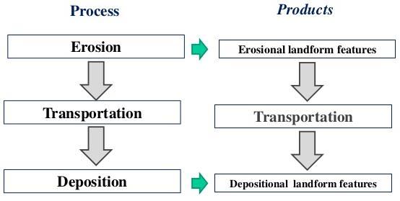
This week…
In this week’s lecture we will look at
  How eroded rock (called clastic sediment) is transported to and deposited in sedimentary basins across the globe.
  The depositional landforms and seascapes that this generates.
  There are other types of sediment which are not derived from eroded rock (called organic sediments and chemical sediments). We will also look at these.

Slide 4
This week…
Landscapes fall into two categories.
“Erosional Landscapes” – generated by uplift, weathering and erosion.
“Depositional Landscapes” generated by subsidence and deposition of sediment. These are also called “sedimentary” environments.
This week we focus exclusively on Depositional Landscapes, and how they form.

Slide 5
The difference between an erosional and depositional landscape
Because erosional landscapes are dominated by UPLIFT, and WEATHERING AND EROSION, they
  → tend to have topographic relief, and
  → are dominated surfaces covered in weathering products (“regloith”), or
  → or dominated by bare eroding bedrock.
By contrast, depositional landscapes are dominated by SUBSIDENCE and DEPOSITION of sediment, are
  → low areas, either flooded by the lakes or sea, if they haven’t been filled with sediment, or
  → very flat (little relief) if they have been filled up with sediment.
  → characterised by bedrock buried under 10 to 100s m of sediment.
This week

Slide 6
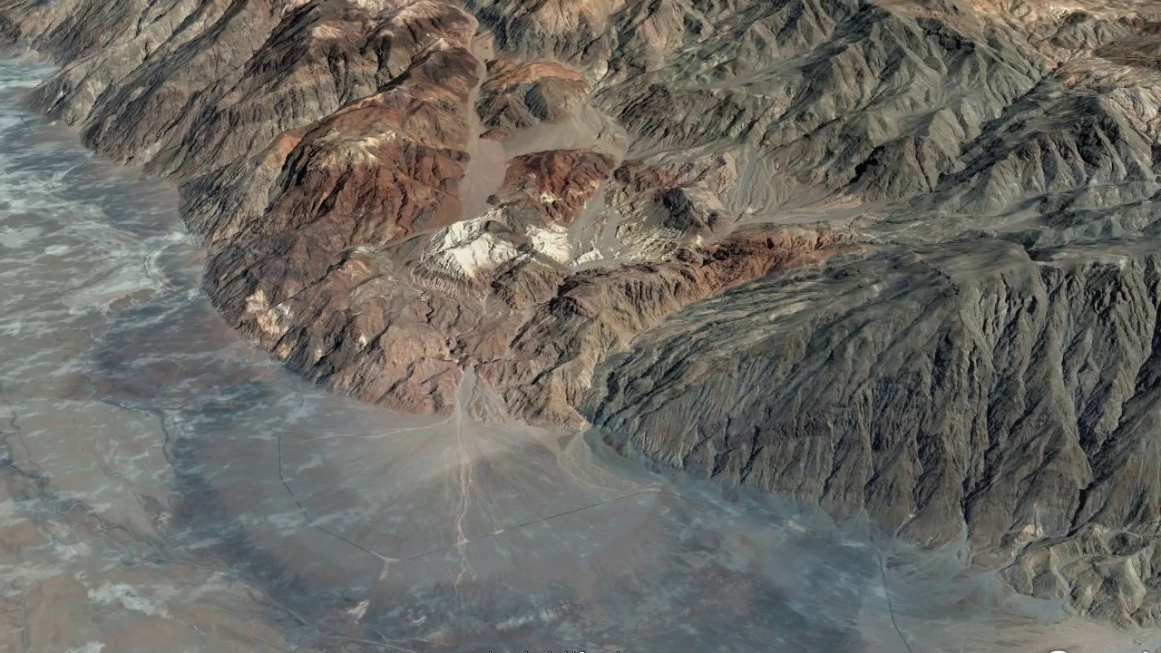
The difference between an erosional and depositional landscape
High relief
Bedrock and regolith at surface
Uplift
Low relief
Bedrock buried under thick sediment
Subsidence
Releasing double bed (Normal) fault
Death Valley, California

Slide 7
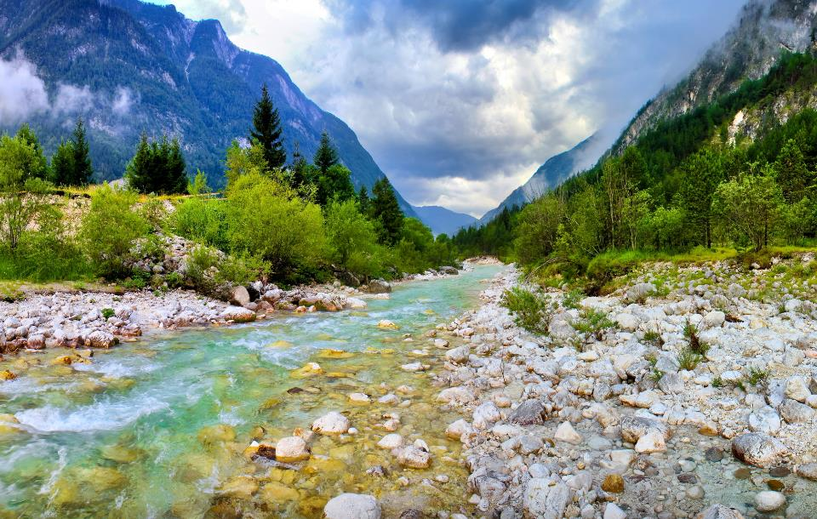
Where does deposition happen?
When weathering and erosion generate clastic sediment (W7), it is transported, and then ultimately deposited somewhere else.
Deposition happens because the capacity of the transporting medium (usually water, but also wind) to carry the sediment decreases.
This can happen locally for short periods of time, anywhere.

Slide 8
Where does deposition happen?
However, for the long-term storage of sediment, we need to generate space for that sediment to be deposited in.
This “space” is often referred to as “accommodation”, and is generated by subsidence of the Earth’s crust (W5).
Long term storage of sediment occurs in sedimentary basins
  → the subsidence of the sedimentary basin also ensures burial of the sediment with later sediment
  → this burial takes the sediment to higher pressures and temperatures, where it can also be converted from sediment into a sedimentary rock.

Slide 9
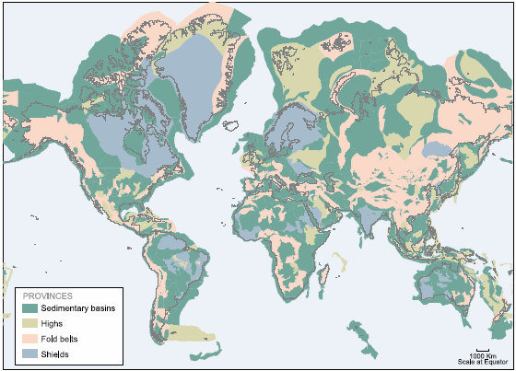
Where does deposition happen?
The modern global distribution of subsiding areas (sedimentary basins) is shown in green.
These are areas where there is potential to accumulate sediment long-term (at the moment).
Other areas are actively uplifting, or are still “high”, and sources of clastic sediment.
These include areas on land, and in the sea, close to continents.
The “deep” ocean (floored by ocean crust) is not considered basin, because
  there are few mechanisms for getting much sediment that far out.
  oceanic crust with any sediment on will subduct into the mantle anyway.

Slide 10
Where does deposition happen?
As with the whole Earth System, deposition is governed by a dynamic equilibrium
  →between the amount of sediment delivered, and the amount of space made available to deposit the sediment by subsidence.
Erosion is primarily driven by fluvial (but also glacial and wind) processes in high areas (W7).
As transporting river systems enter a sedimentary basin, it will begin to deposit its sediment load to “fill” the available space.
  →if the volume of space being generated ≥ volume of sediment being delivered, then all the sediment will be deposited.
  → if the volume of space being generated < volume of sediment being delivered, then the excess sediment will continue its journey down system to a place where there is sufficient space.

Slide 11
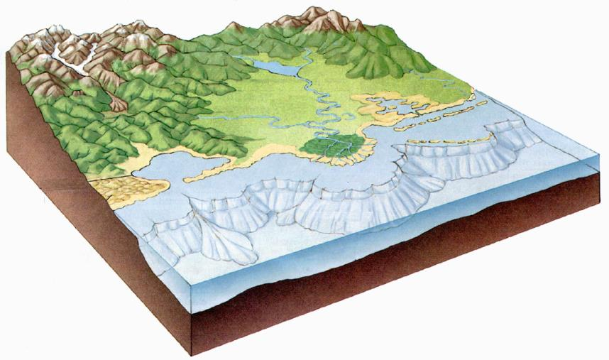
Where does deposition happen?
Consequently, clastic sediment can be deposited,
Weathering
& erosion
1. Fluvial
2. Aeolian
4. “Deep”
water
3. “Shallow” water

Slide 12
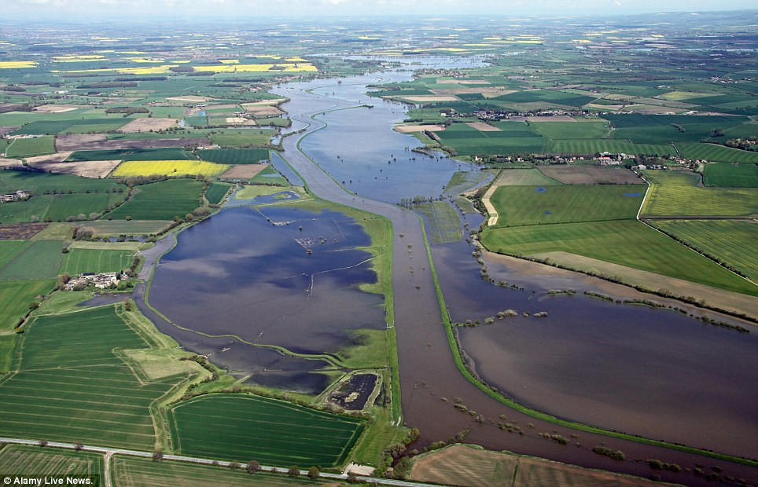
Fluvial systems
Levee
Flood plain
Channel

Slide 13
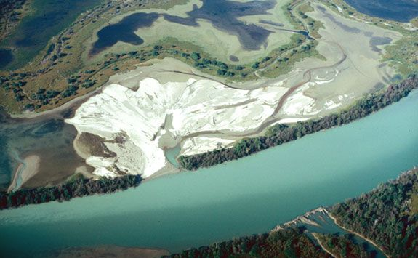
Fluvial systems
Crevasse splay
Levee
Channel

Slide 14
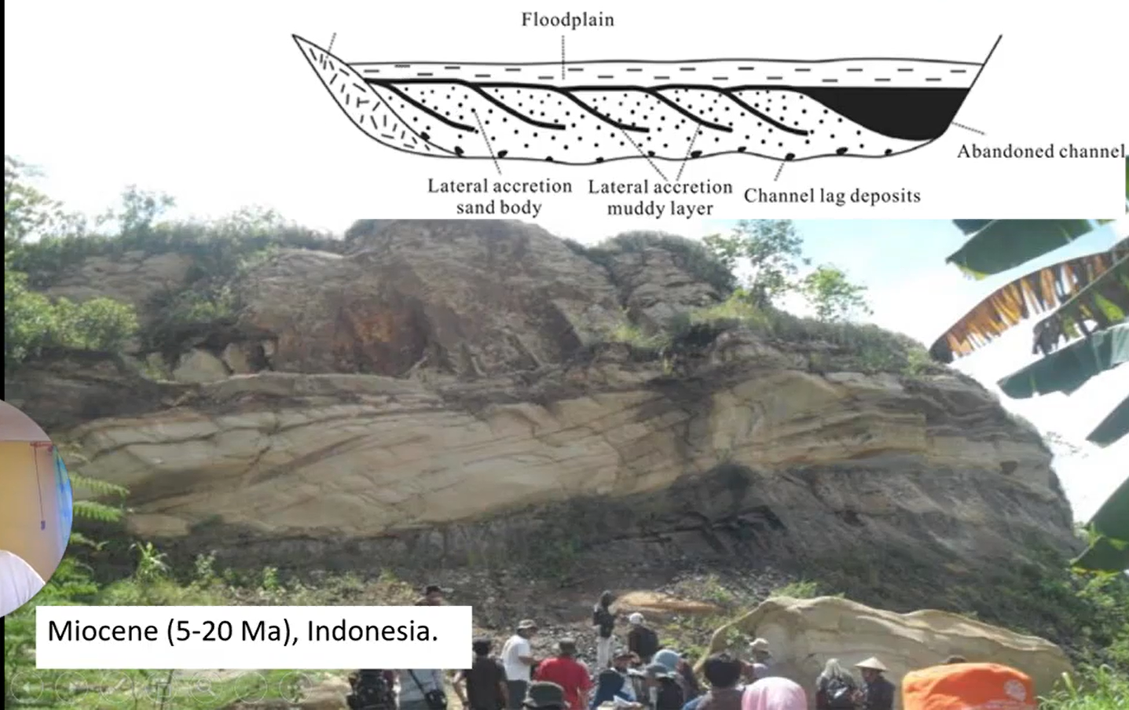

Slide 15
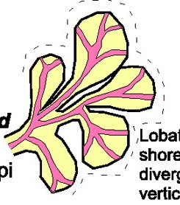
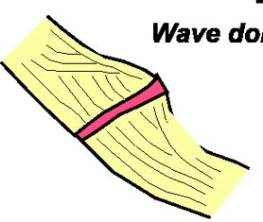
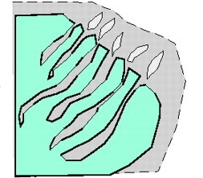
Shallow marine systems?
Lobate coastlines
Deltas
Rivers
Linear coastlines
Strandplains, spits, beaches and lagoons
Embayed coastlines
Estuaries and tidal flats
Waves
Tides

Slide 16
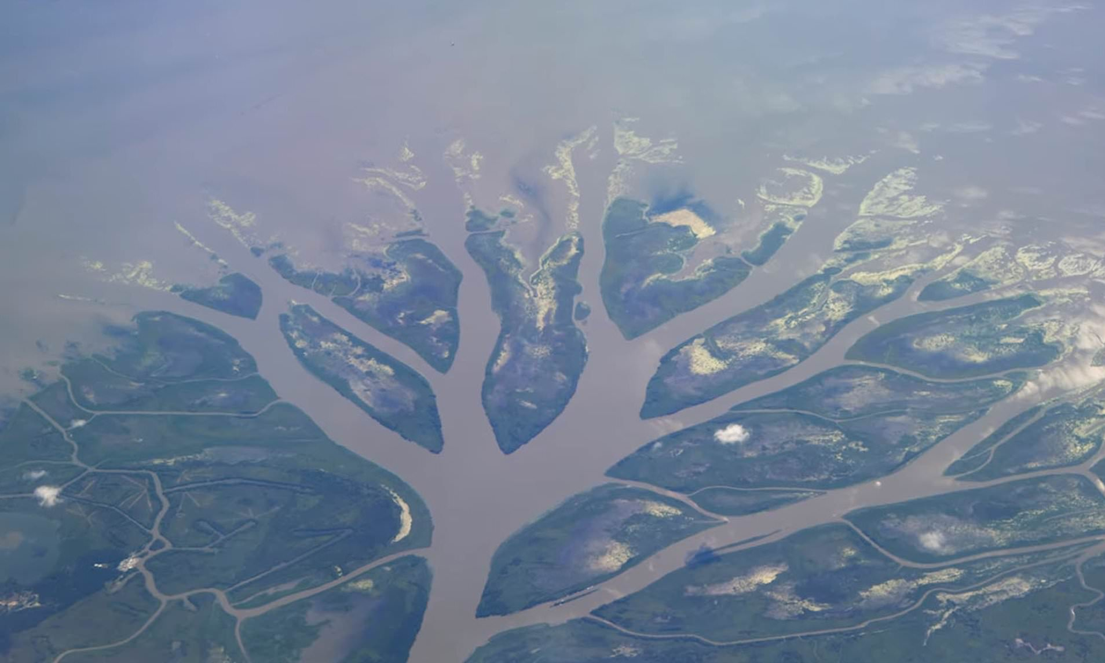
River-dominated systems: deltas
Mouth bar
Mouth bar
Mouth bar
Channel

Slide 17
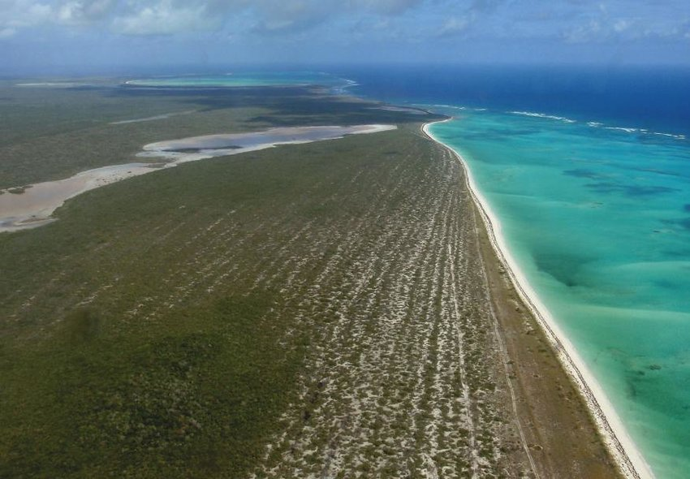
Wave-dominated systems:
linear “shorefaces”
Standplain
Beach

Slide 18
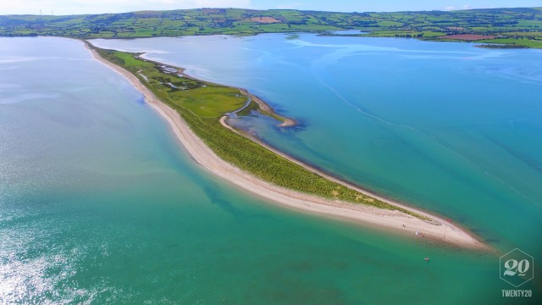
Wave-dominated systems:
linear “shorefaces”
Spit
Beach

Slide 19
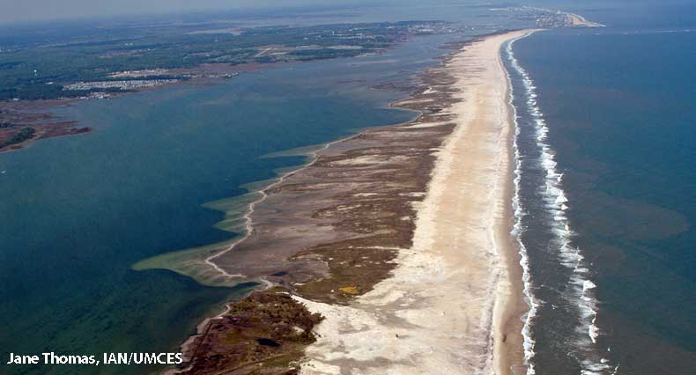
Wave-dominated systems:
linear “shorefaces”
Lagoon
Beach barrier

Slide 20
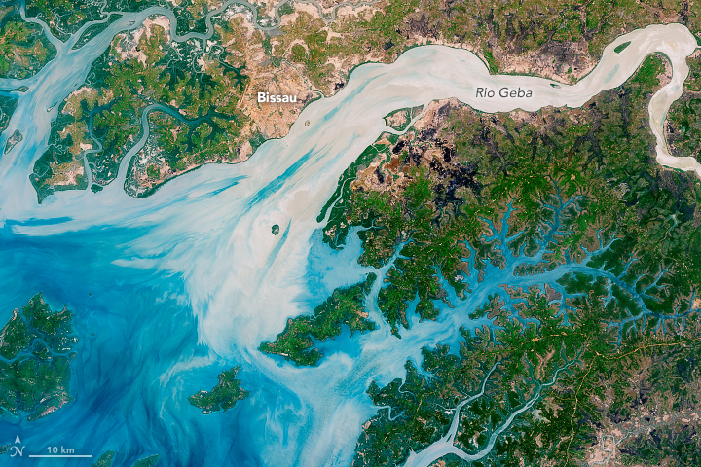
Tide dominated systems: estuaries
Estuary

Slide 21
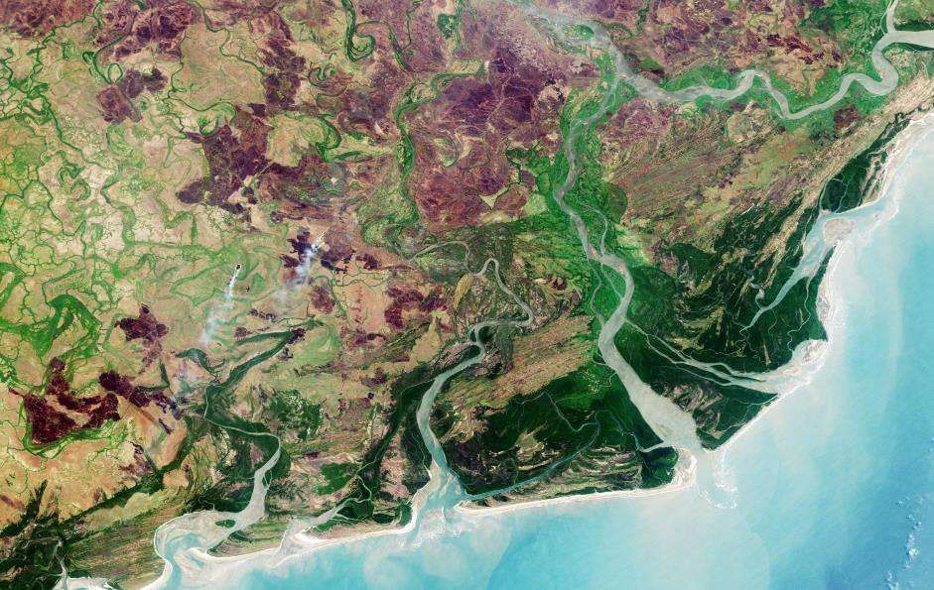
Summary
In many settings it is possible to see the influence of all of these processes on the routing and deposition of sediment.
Zambezi Delta, Mozambique.
Spit: longshore drift
Mouthbar: Decelerating fluvial currents
Spit: Longshore drift
Funnel shape: tidal excavation

Slide 22
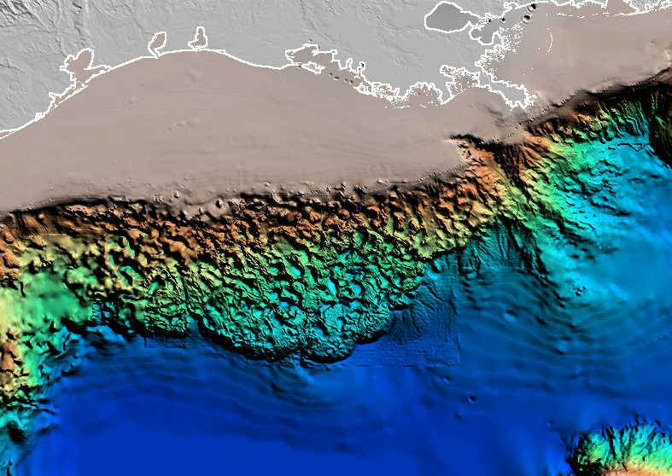
Deep water
Mississippi Delta
220 km wide shelf
Nearly no shelf
If you look at Bathymetry data from around the world you will see that the continents are surrounded by marine shelves
Sometimes the shelf is narrow, sometimes it’s wide.
Bathymetry of the North Gulf of Mexico

Slide 23
Deep water
Bathymetry of the North Gulf of Mexico
Mississippi Delta
Continental shelf
(gradient ~0.05º)
Continental slope
(gradient 0.1 – 2º)
Continental shelves are flat areas of continental crust that are flooded by the sea.
They are separated from low-lying Oceanic Crust by steeper slopes.
Ocean floor
(gradient <0.1º)

Slide 24
Deep water
Bathymetry of the North Gulf of Mexico
Mississippi Delta
220 km wide shelf
Where rivers, deltas, or shorefaces are able to cross the shelf and deliver sediment to the continental slope (e.g. the Mississippi Delta)…
…A COMPLETELY DIFFERENT SET OF PROCESSES START TO HAPPEN!
These are mass wasting and transport processes.

Slide 25
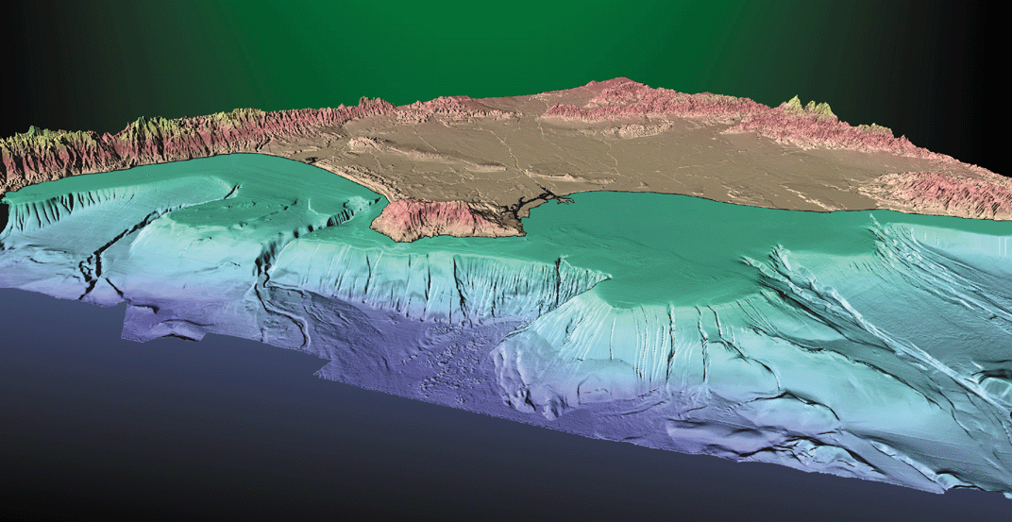
Deep water
Commonly, canyons cut back from the Ocean floor through the shelf and can “tap” sediment directly from deltas or shorefaces.
Earthquakes, or oversteepening of the sediment deposited there causes landslides.
Bathymetry of Southern California
Canyon
Edge of continental shelf
Ocean Floor
Slope

Slide 26
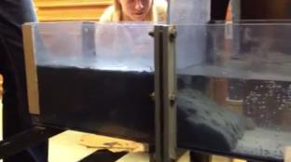
Debris flows and turbidity currents occur because the mix of sediment and water is denser than the ambient medium (seawater).
So they flow because of their gravitational potential.
VIDEO
http://www.youtube.com/watch?v=bZniPhc_7N8&list=PLC87618DCCC0912DE&index=3
Both processes happen on land and underwater, if the gradient is great enough, and the concentration of the flow is high enough.
  →Turbidity currents on land are usually Volcanic, and are called Pyroclastic Flows (W3).

Slide 27
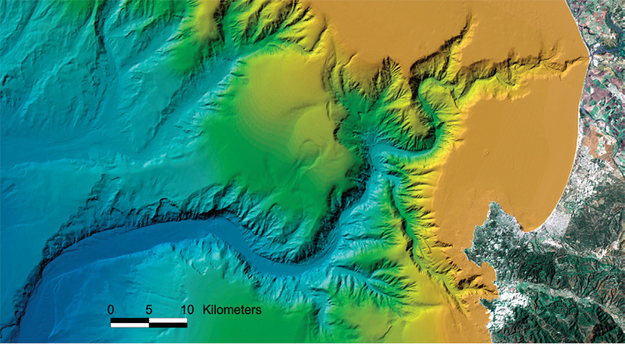
Monterey Canyon, California

Slide 28
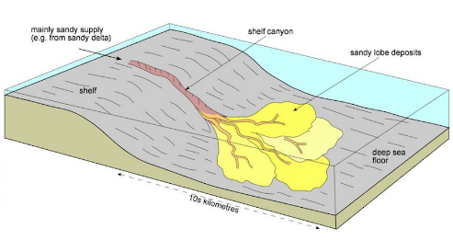
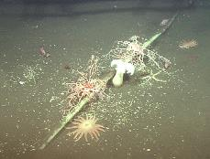
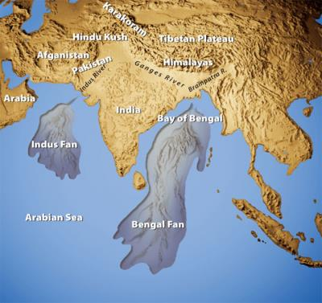
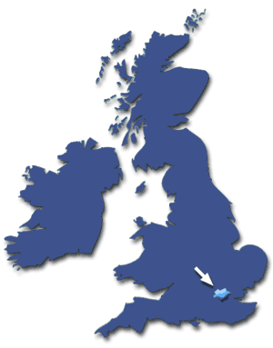
Clastic depositional environments: deep water
Submarine (“deep water”) fans are the largest sedimentary deposits on Earth.
They are the final resting place for any particle that has been eroded from a “high area”.
The processes occurring in these deep water conditions were a mystery until very recently
They pose a major risk to submarine infrastructure.

